Slide 1
Digital Logic Design
Chapter 2
Boolean Algebra and Logic gates

Slide 2
Basic Theorems
Postulate 2 | (a) x + 0 = x | (b) x . 1 = x
Postulate 5 | (a) x + x’ = 1 | (b) x . x’ = 0
Theorem 1 | (a) x + x = x | (b) x . x = x
Theorem 2 | (a) x + 1 = 1 | (b) x . 0 = 0
Theorem 3, involution | (x’)’ = x
Postulate 3, commutative | (a) x + y = y +x | (b) xy = yx
Theorem 4, associative | (a) x+ (y+z) = (x+y) + z | (b) x(yz) = (xy)z
Postulate 4, distributive | (a) x(y+z) = xy + xz | (b) x + yz = (x+y)(x+z)
Theorem 5, DeMorgan | (a) (x + y)’ = x’y’ | (b) (xy)’ = x’ + y’
Theorem 6, absorption | (a) x + xy = x | (b) x(x + y) = x

Slide 3
Boolean Function
A binary variable can take the value 0 or 1.
A Boolean function is an expression formed with binary variables, the two binary operators OR and AND, the unary operator NOT, parentheses and equal sign.
For example: F₁ = xyz’ , F₂ = x + y’z
A Boolean function may also be represented in a truth table. To represent a function in a truth table, we need a list of 2^{n} combinations of 1’s and 0’s of the n binary variables and a column showing the combinations for which the function is equal to 1 or 0.

Slide 4
Boolean Function
x | y | z | F₁ | F₂ | F₃ | F₄
0 | 0 | 0 | 0 | 0 | 0 | 0
0 | 0 | 1 | 0 | 1 | 1 | 1
0 | 1 | 0 | 0 | 0 | 0 | 0
0 | 1 | 1 | 0 | 0 | 1 | 1
1 | 0 | 0 | 0 | 1 | 1 | 1
1 | 0 | 1 | 0 | 1 | 1 | 1
1 | 1 | 0 | 1 | 1 | 0 | 0
1 | 1 | 1 | 0 | 1 | 0 | 0
Truth tables for F₁ = xyz’, F₂ = x + y’z, F₃ = x’y’z + x’yz + xy’ and F₄ = xy’ + x’z

Slide 5
Boolean Function
Simplify the following Boolean functions to a minimum number of literals.
x’y’z + x’yz + xy’
= x’z(y’ + y) + xy’
= x’z + xy’
xy + x’z + yz
= xy + x’z + yz(x + x’)
= xy + x’z + xyz + x’yz
= xy(1 + z) + x’z(1 + y)
= xy + x’z

Slide 6
Complement of a Function
Find the complement of the functions F₁ = x’yz’ + x’y’z
F₁’ = (x’yz’ + x’y’z)’
= (x’yz’)’(x’y’z)’
= (x + y’ + z)(x + y + z’)
Find the complement of the functions F₂ = x(y’z’ + yz)
F₂’ = (x(y’z’ + yz))’
= x’ + (y’z’ + yz)’
= x’ + (y’z’)’(yz)’
= x’ + (y + z)(y’ + z’)

Slide 7
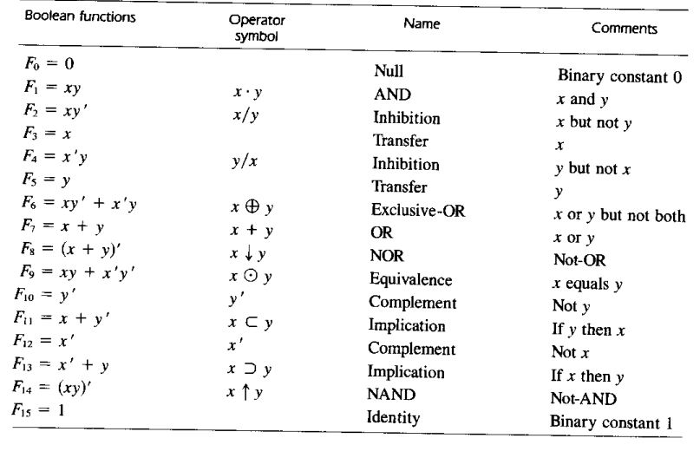
Other Logic Operations

Slide 8
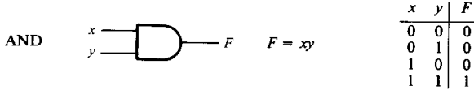
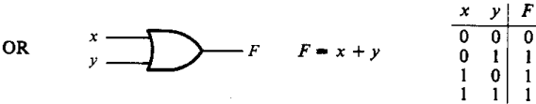


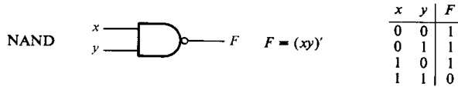
Digital Logic Gates

Slide 9
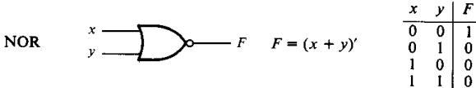
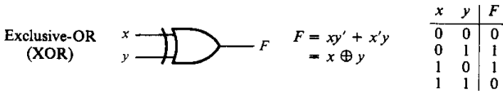
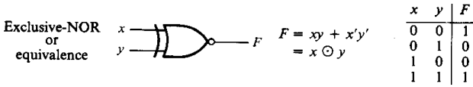
Digital Logic Gates

Slide 10
Canonical & Standard Forms
Minterms & Maxterms:
Let us consider two binary variables x and y combined with an AND operation.
Since each variable may appear either in its normal form or in its complement form, there are four combinations: x’y’, x’y, xy’ and xy.
Each of these four AND terms represents a minterm.
Similarly, n variables forming an OR term, with each variable being primed or umprimed, provide 2^{n} possible combinations, called maxterms.

Slide 11
Canonical & Standard Forms
Boolean functions expressed as a sum of minterms or product of maxterms are said to be in Canonical form.
For example:
f₁ = x’y’z + xy’z’ + xyz
= m₁ + m₄ + m₇
f₂ = (x+y+z)(x+y+z’)(x+y’+z)(z’+y+z)
= M₀M₁M₂M₄

Slide 12
Canonical & Standard Forms
The terms that form a Boolean function may contain one, two or any number of literals. These are said to be in standard forms.
Two types of standard forms:
Sum of products
Product of sums
For example:
F₁ = y’ + xy + x’yz’
F₂ = x(y’+z)(x’+y+z’)

Slide 13
Conversion Between Canonical Forms
Let a function be F(A, B, C) = Ʃ(1, 4, 5, 6, 7)
The function has a complement that can be expressed as:
F’(A, B, C) = Ʃ(0, 2, 3) = m₀ + m₂ + m₃
Now if we take the complement of F’ by DeMorgan’s theorem, we obtain F in a different form:
F = (m₀ + m₂ + m₃)’ = m₀’.m₂’.m₃’ = M₀M₂M₃
= Π(0, 2, 3)
Similarly, for the function F(x, y, z) = Π(0, 2, 4, 5), the conversion to sum of mintems is:
F(x, y, z) = Ʃ(1, 3, 6, 7)

